Slide 1


Slide 2
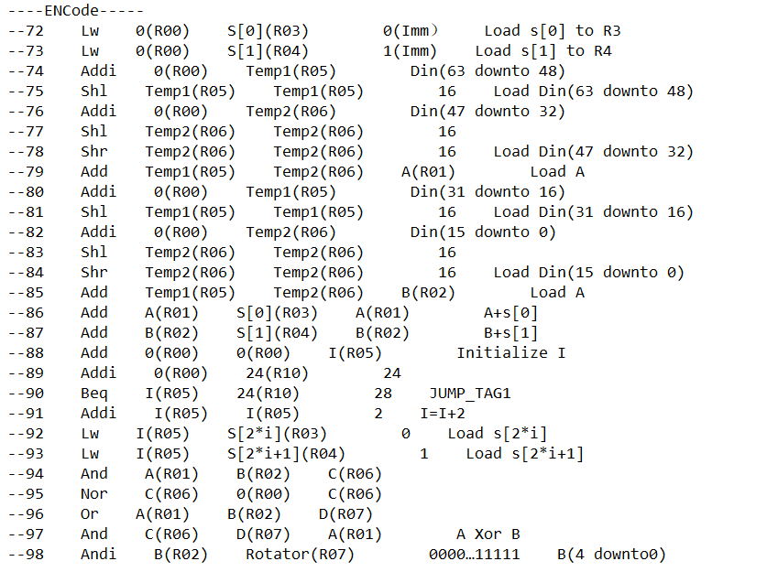
Assembly Code

Slide 3
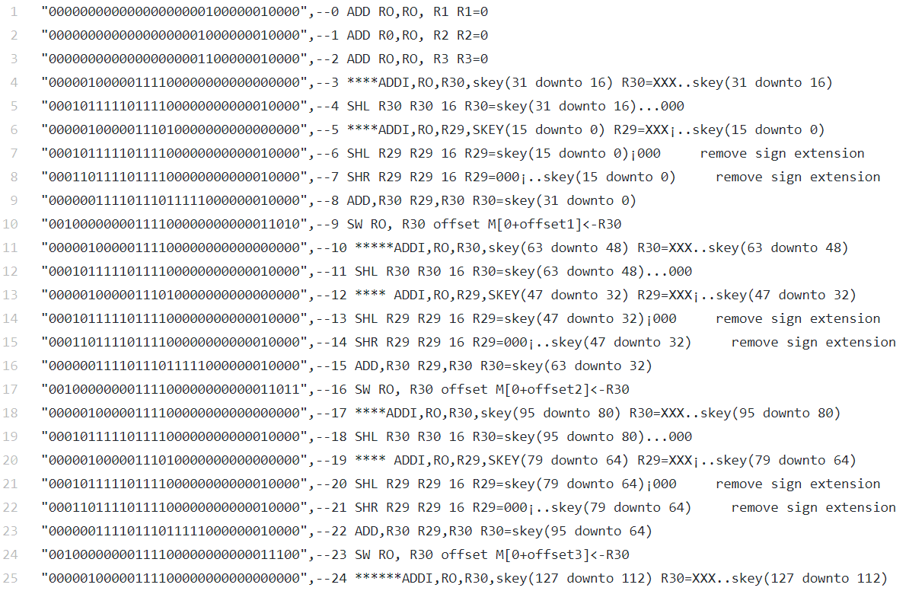
Machine Code

Slide 4
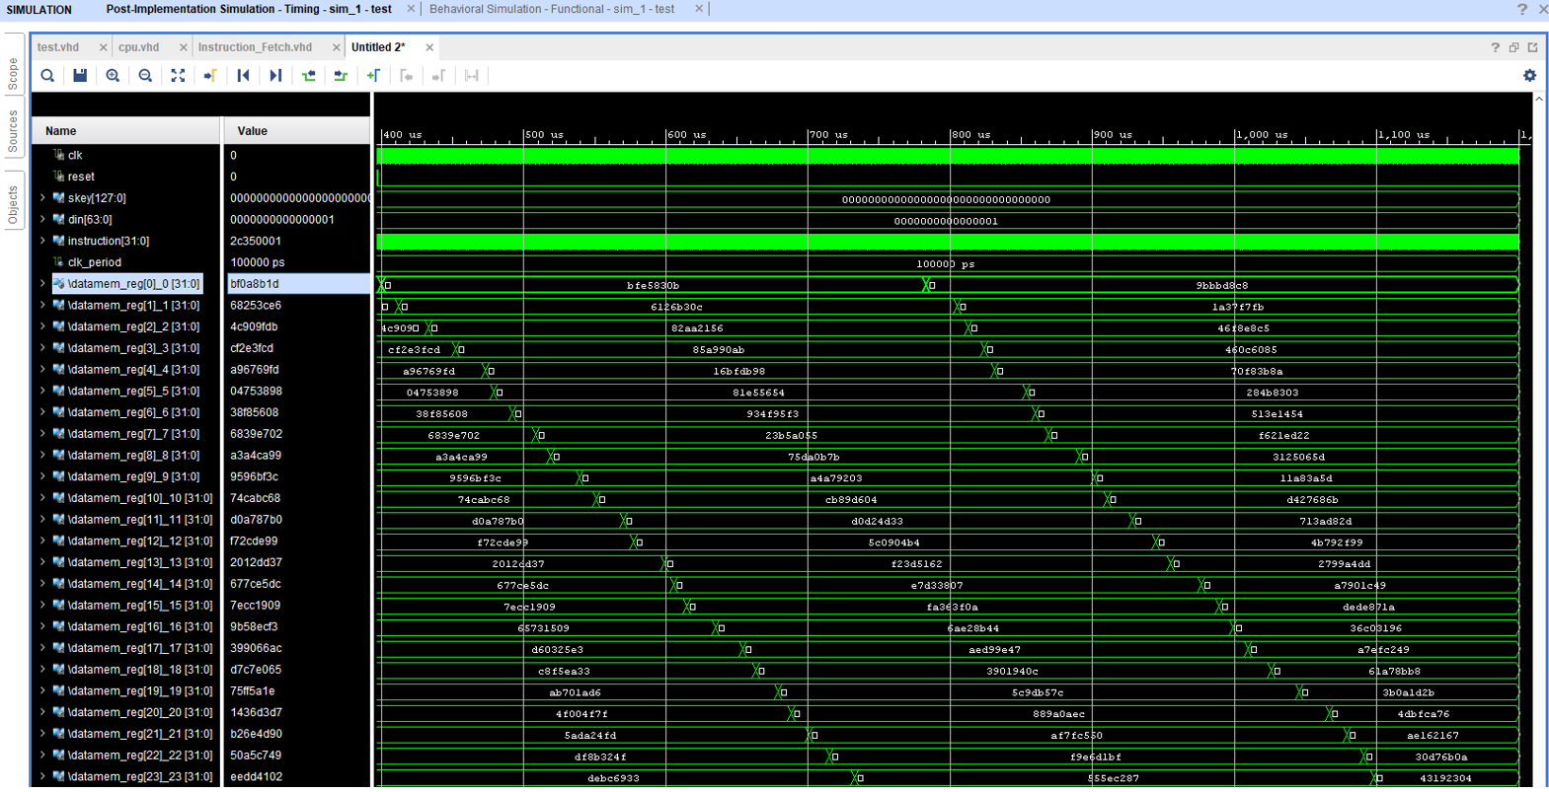
Key Expansion Part Timing Simulation
Notes:
We save the Skey to Data memory[25 downto 0], as we can see the data memory is filled and updated during the simulation.

Slide 5
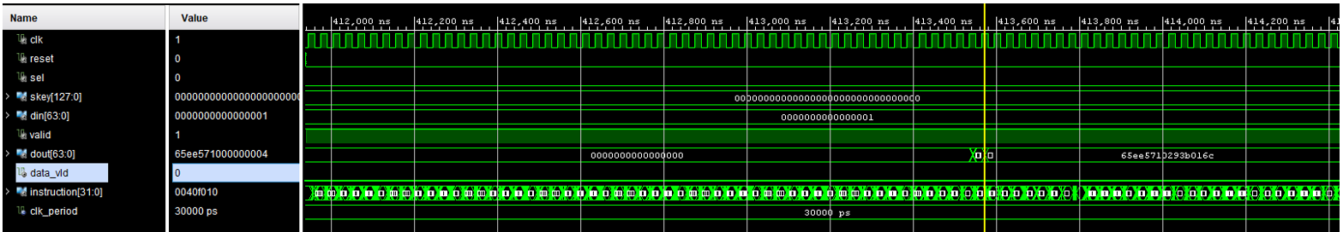
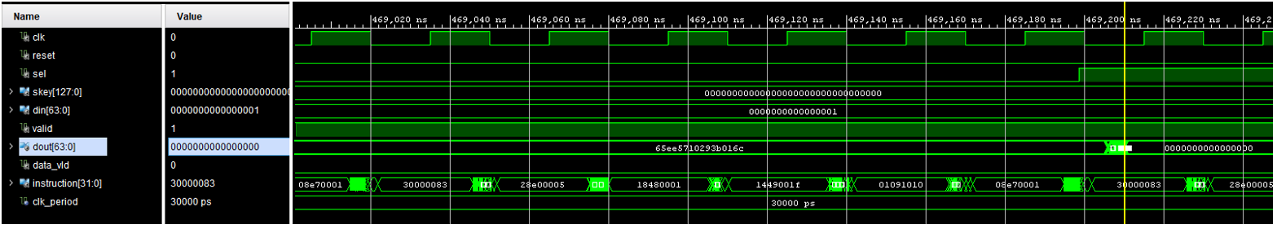
Encoding Part Timing Simulation
Decoding Part Timing Simulation

Slide 6
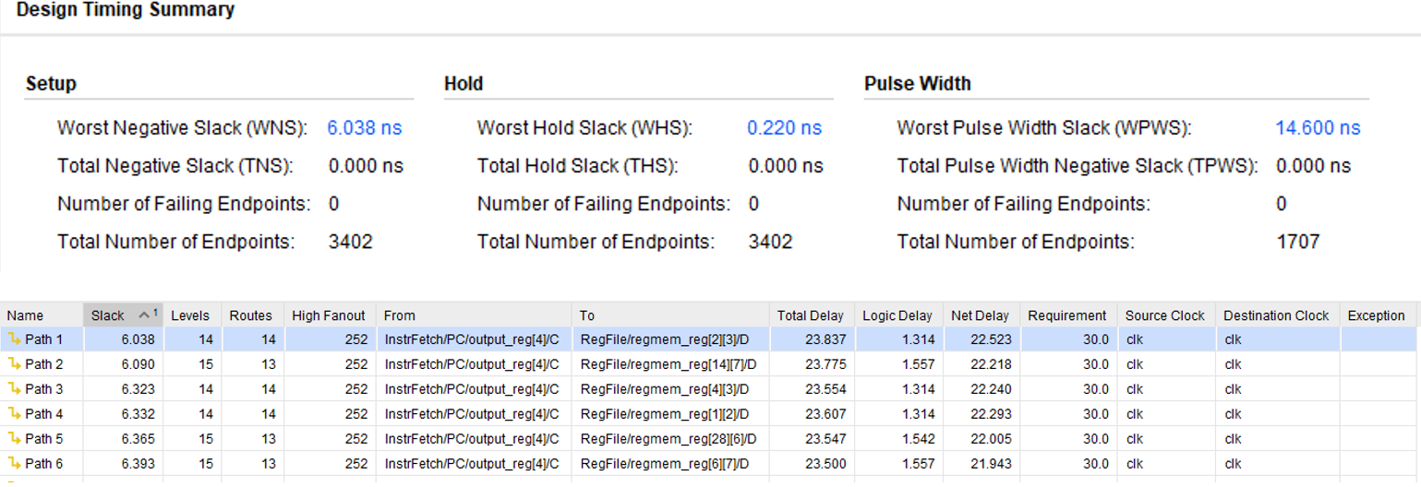
Critical Path Delay
We set the timing constrain to 30ns.
Critical path delay: 23.837ns
Max Frequency: 41.96MHz

Slide 7
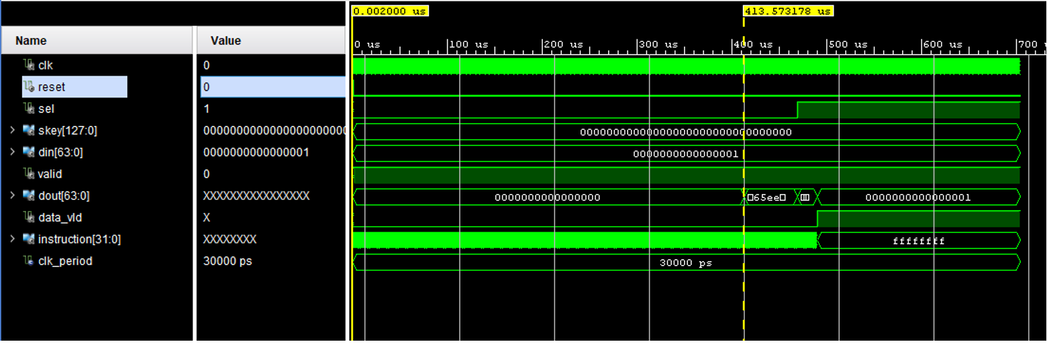

Latency of key expansion + Encode
Latency = $\frac{413.57us−0.02us}{30ns}$ = 13785 clock cycles.

Slide 8
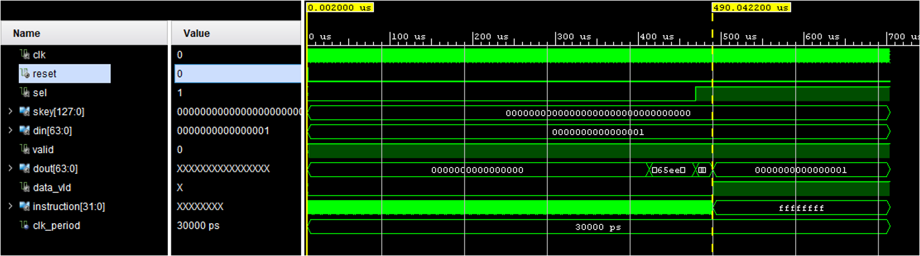

Latency of key expansion +encode + decode
Latency = $\frac{490.04us−0.02us}{30ns}$ = 16334 clock cycles.

